Slide 1

Quantum Shield
A Future-Ready Secure Communication Framework with Hybrid Cryptographic
and Post-Quantum Cryptographic Readiness
STUDENT NAME
REGISTER NUMBER
DEPARTMENT
Pramith
Chandu
Prasad
192372174
192372119
192324187
CSE-AI
CSE-AI
AIDS
COLLEGE
GUIDE
[Saveetha Institute Of Medical and Technical Sciences]
ANBALAGAN E
Editable placeholders — replace with actual details

Slide 2
OVERVIEW
Abstract
1
Secure web-based communication framework resilient to both classical and quantum adversaries
5
Post-quantum digital signatures (CRYSTALS-Dilithium) with SHA-256 for integrity & authenticity (Secure Hash Algorithm)
2
Hybrid Cryptographic Model combining classical algorithms with post-quantum algorithms
6
Defends against "Harvest Now, Decrypt Later" quantum threats
3
RSA-2048 / ECC(Elliptic Curve Crypto) for classical key exchange, layered with post-quantum KEM (CRYSTALS-Kyber)
7
Real-time messaging and encrypted file sharing; server stores only encrypted data
4
AES-256-GCM(Galios Counter Mode) for symmetric message encryption(Advanced Encryption Standard)
8
Interactive cryptographic visualization module for hybrid & PQC operations
User A
→
Hybrid Encryption
(Classical + PQC)
→
Server
→
User B

Slide 3







MOTIVATION
Problem Statement & Objectives
Build a secure real-time messaging app resilient to classical and quantum attacks
Problem Statement
Implement a Hybrid Cryptographic model (classical + post-quantum)
Traditional messaging systems rely solely on classical cryptography (RSA/ECC), vulnerable to future quantum computers running Shor's Algorithm.
Integrate post-quantum key encapsulation and digital signatures
Ensure only sender and receiver can read messages
Adversaries can harvest encrypted data today and decrypt it once large-scale quantum computers become available — putting long-term confidentiality at risk.
Protect user privacy against present and future quantum threats
Demonstrate cryptographic operations via interactive visualization
⚠ "Harvest Now, Decrypt Later"
Build a scalable, quantum-ready web application using modern tech

Slide 4
RELATED WORK
Literature Survey
Existing systems and research on hybrid & post-quantum secure communication (2024 – 2025)
Year | Study / System | Approach | Key Contribution
2025 | Signal PQXDH (Kret & Schmidt, Signal Foundation) | Kyber (ML-KEM) + X25519 hybrid key agreement | Deployed hybrid PQC in a production E2E messenger; mitigates "harvest now, decrypt later"
2024–25 | Chrome / Cloudflare Hybrid TLS (Google, Cloudflare) | X25519Kyber768 hybrid key exchange in TLS 1.3 | Largest real-world PQC rollout to date; validated hybrid PQC at internet scale
2025 | Rubio-Garcia et al., IEEE CAMAD | Quantum-resistant TLS 1.3 combining classical, quantum & PQC | Hybrid handshake integrating QKD with PQC for TLS channels
2024 | Garms et al., Adv. Quantum Technologies | Muckle++ hybrid QKD + PQC key exchange protocol | Experimental hybrid quantum-safe cryptosystem with forward & post-compromise security
2025 | Alnahawi et al., IACR CiC | Comprehensive survey of Post-Quantum TLS | Systematized migration strategies and open challenges for PQ-secure transport protocols
2025 | Buruaga et al., Computer Networks | Hybrid quantum-safe TLS integration in SDN networks | Extends hybrid PQC beyond point-to-point links into programmable network infrastructure
Research Gap: Prior work targets TLS/browser transport or requires dedicated QKD hardware. Quantum Shield applies hybrid classical + PQC (Kyber + Dilithium) directly to an application-layer, real-time chat system with zero plaintext server storage.

Slide 5
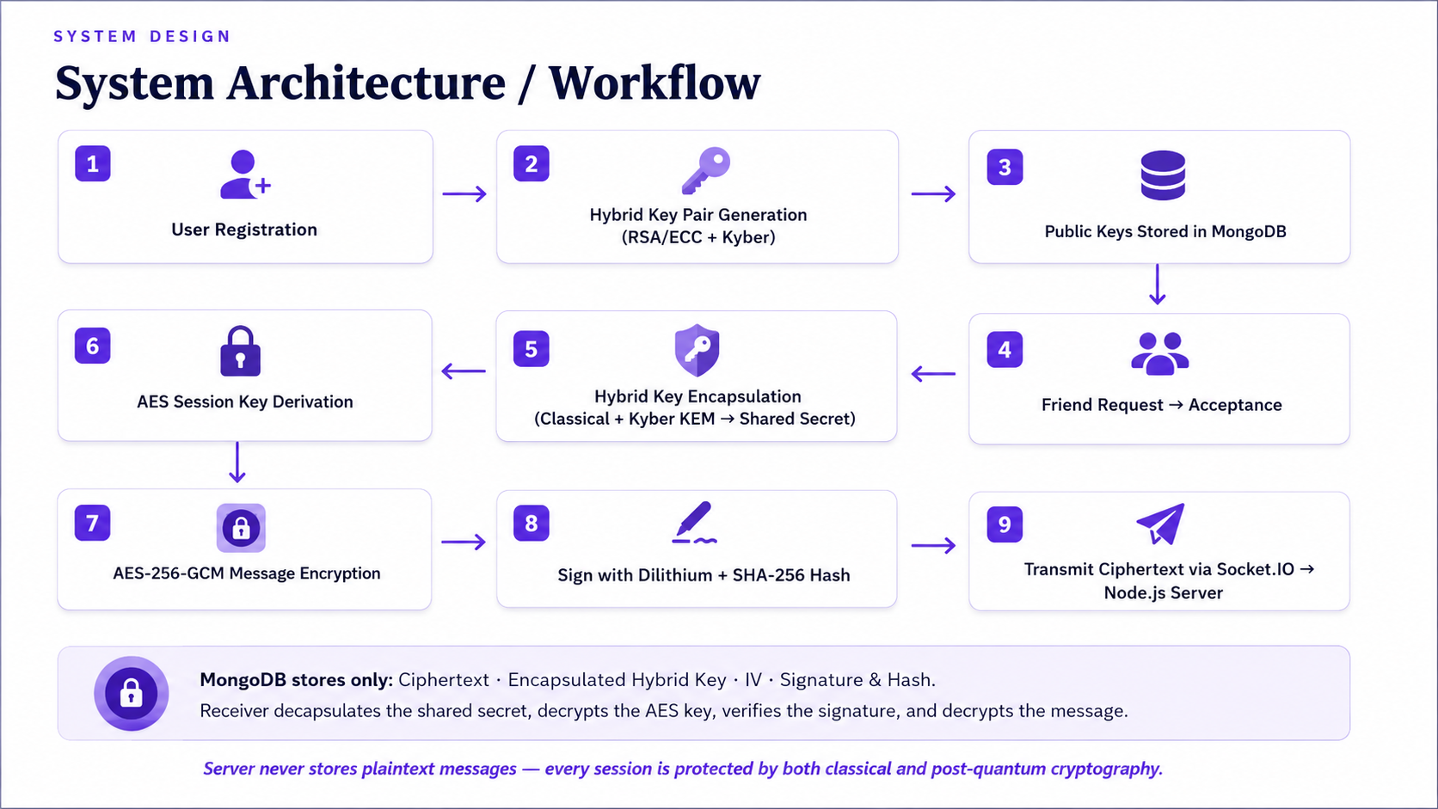

SYSTEM DESIGN
System Architecture / Workflow
1
User Registration
2
Hybrid Key Pair Generation
(RSA/ECC + Kyber)
3
Public Keys Stored in MongoDB
→
→
↓
6
AES Session Key Derivation
5
Hybrid Key Encapsulation
(Classical + Kyber KEM → Shared Secret)
4
Friend Request → Acceptance
→
→
↓
7
AES-256-GCM Message Encryption
8
Sign with Dilithium + SHA-256 Hash
9
Transmit Ciphertext via Socket.IO → Node.js Server
→
→
MongoDB stores only: Ciphertext · Encapsulated Hybrid Key · IV · Signature & Hash. Receiver decapsulates the shared secret, decrypts the AES key, verifies the signature, and decrypts the message.
Server never stores plaintext messages — every session is protected by both classical and post-quantum cryptography.

Slide 6


ENGINEERING
Technology Stack
Frontend
Backend
Database
React
Vite
TypeScript
Tailwind CSS
Node.js
Express.js
Socket.IO
MongoDB
Mongo Express
Security — Classical
Security — Post-Quantum
Storage & Deployment
RSA-2048 / ECC
AES-256-GCM
SHA-256
JWT
bcrypt
CRYSTALS-Kyber (KEM)
CRYSTALS-Dilithium (Signatures)
liboqs / Open Quantum Safe
Cloudinary
Docker
Docker Compose

Slide 7
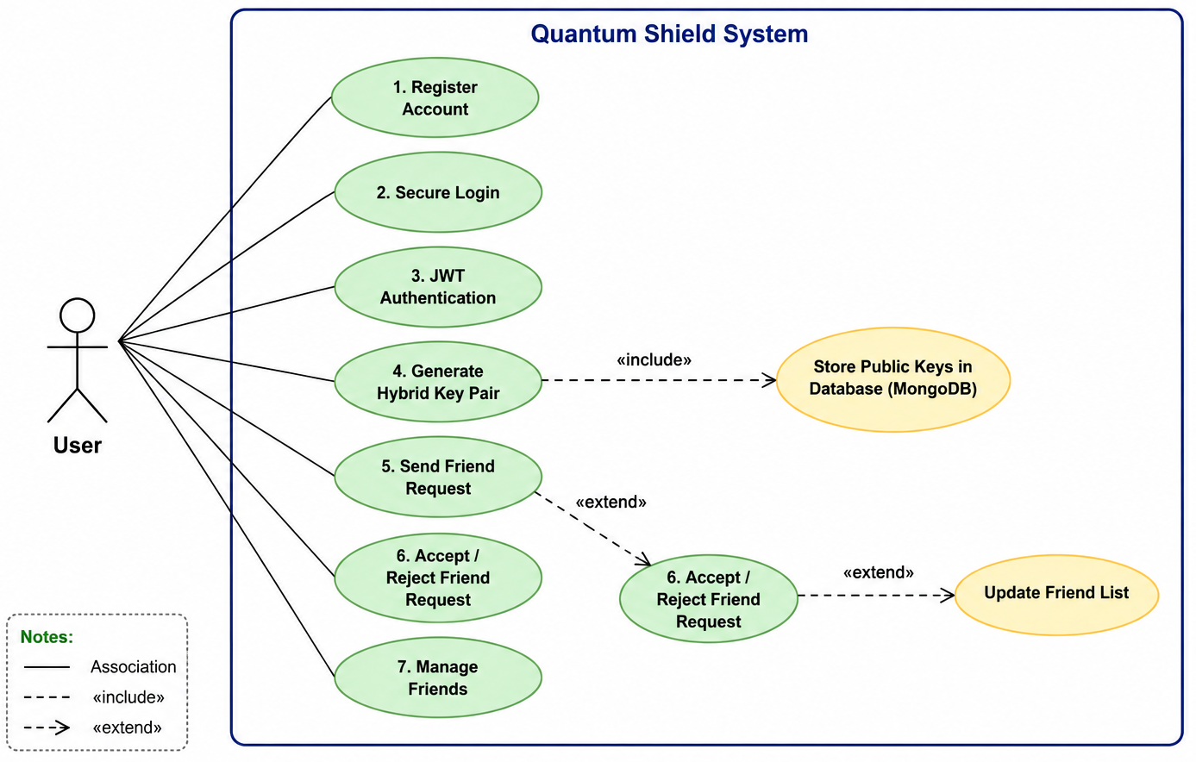
IMPLEMENTATION
Core Modules
Module 1
Authentication & User Management
User Registration
Secure Login
JWT Authentication
Password Hashing (bcrypt)
Hybrid Key Pair Generation (RSA/ECC + Kyber)
Friend Request Management

Slide 8
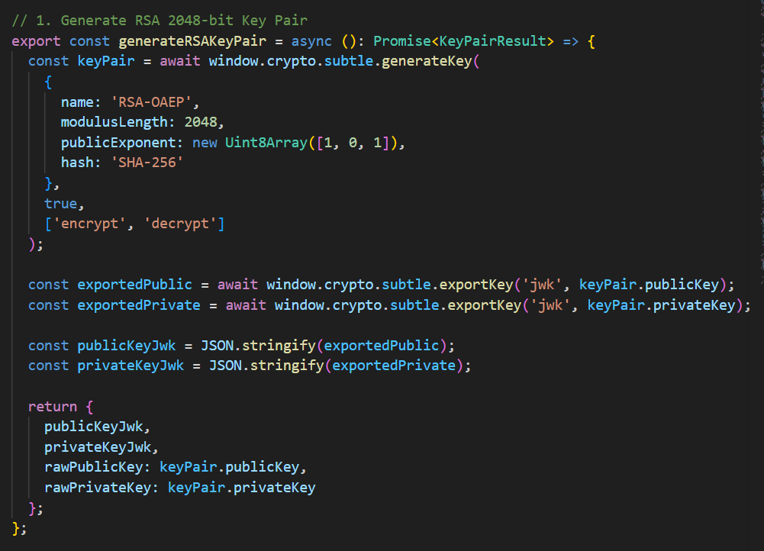

Slide 9
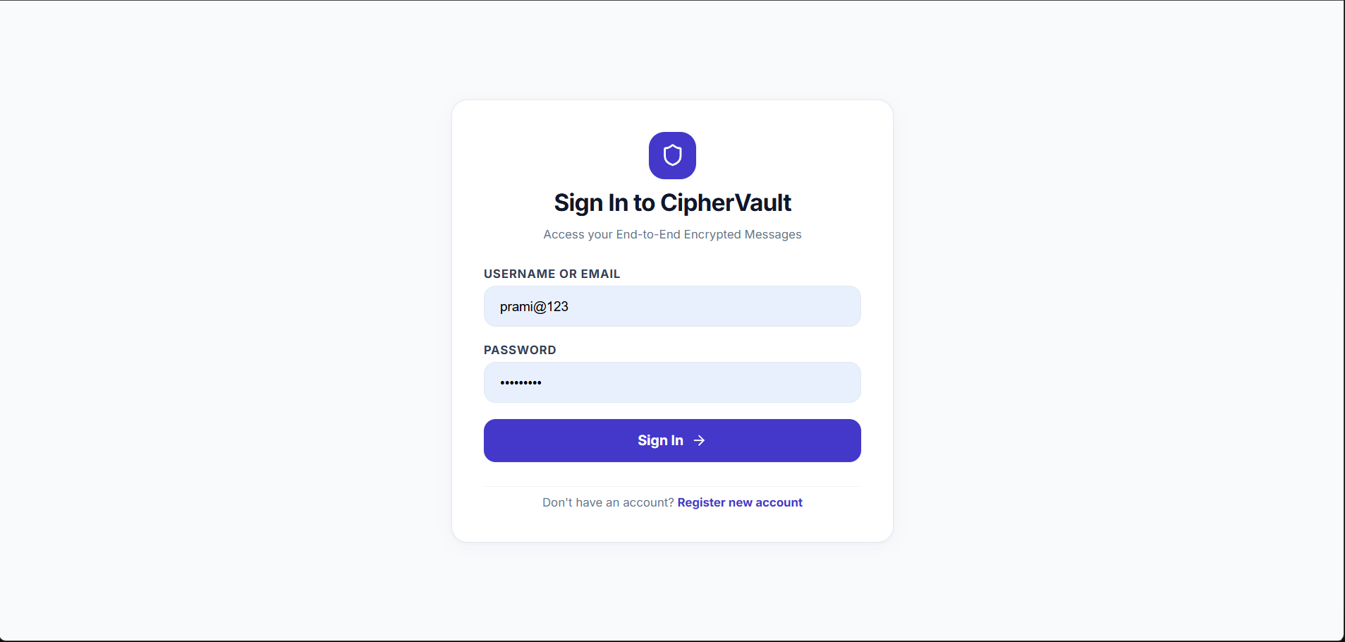
Module 1: Output

Slide 10

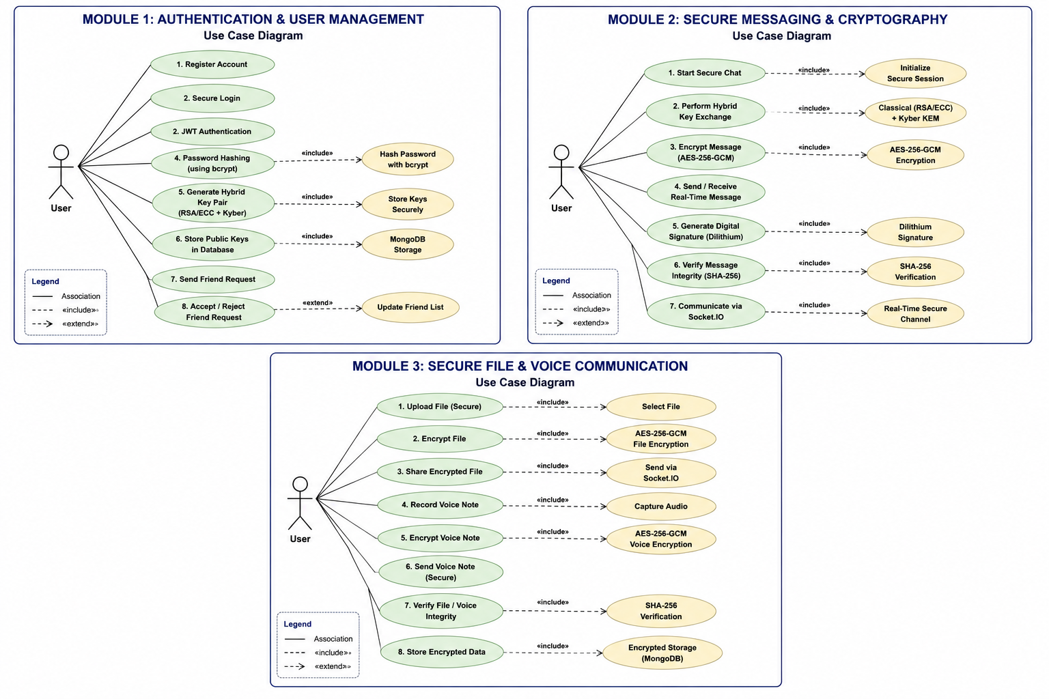
Module 2
Secure Messaging & Cryptography
Start Secure Chat
AES-256 Message Encryption
Hybrid Key Exchange (Classical + PQC KEM)
Real-Time Message Sending/Receiving
CRYSTALS-Dilithium Digital Signature
SHA-256 Integrity Verification
Secure Socket.IO Communication

Slide 11
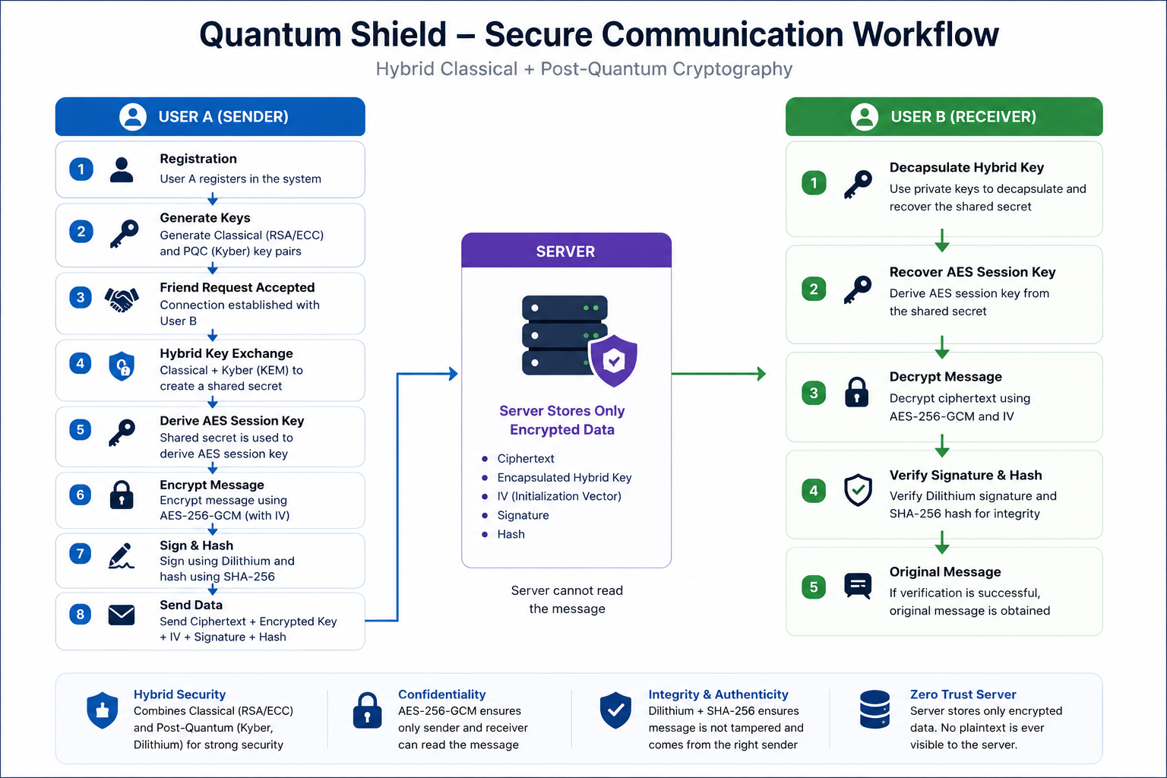

Slide 12
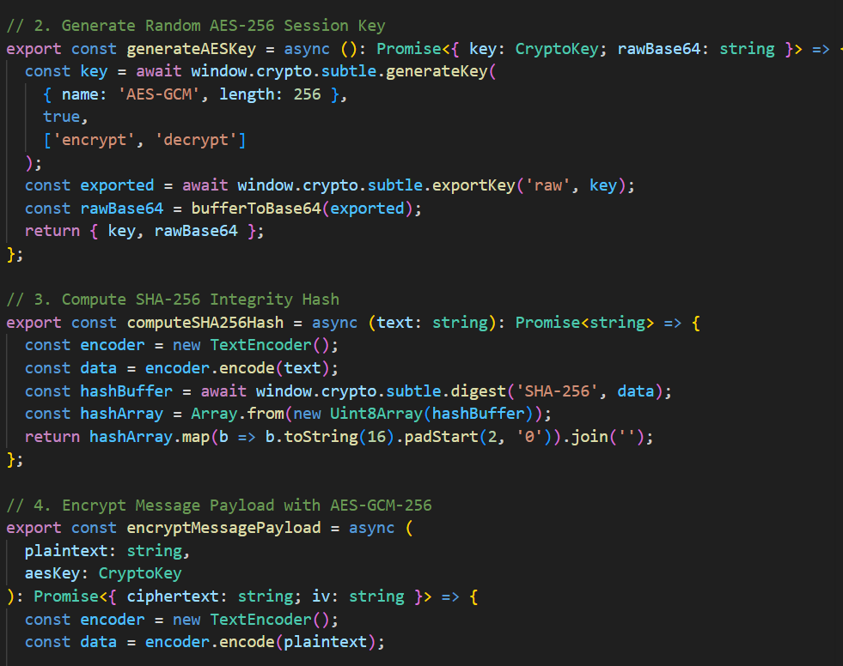
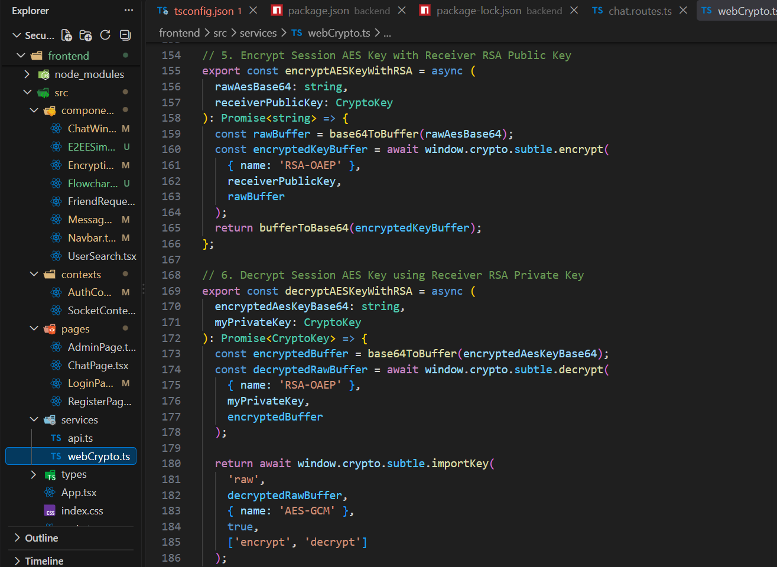

Slide 13
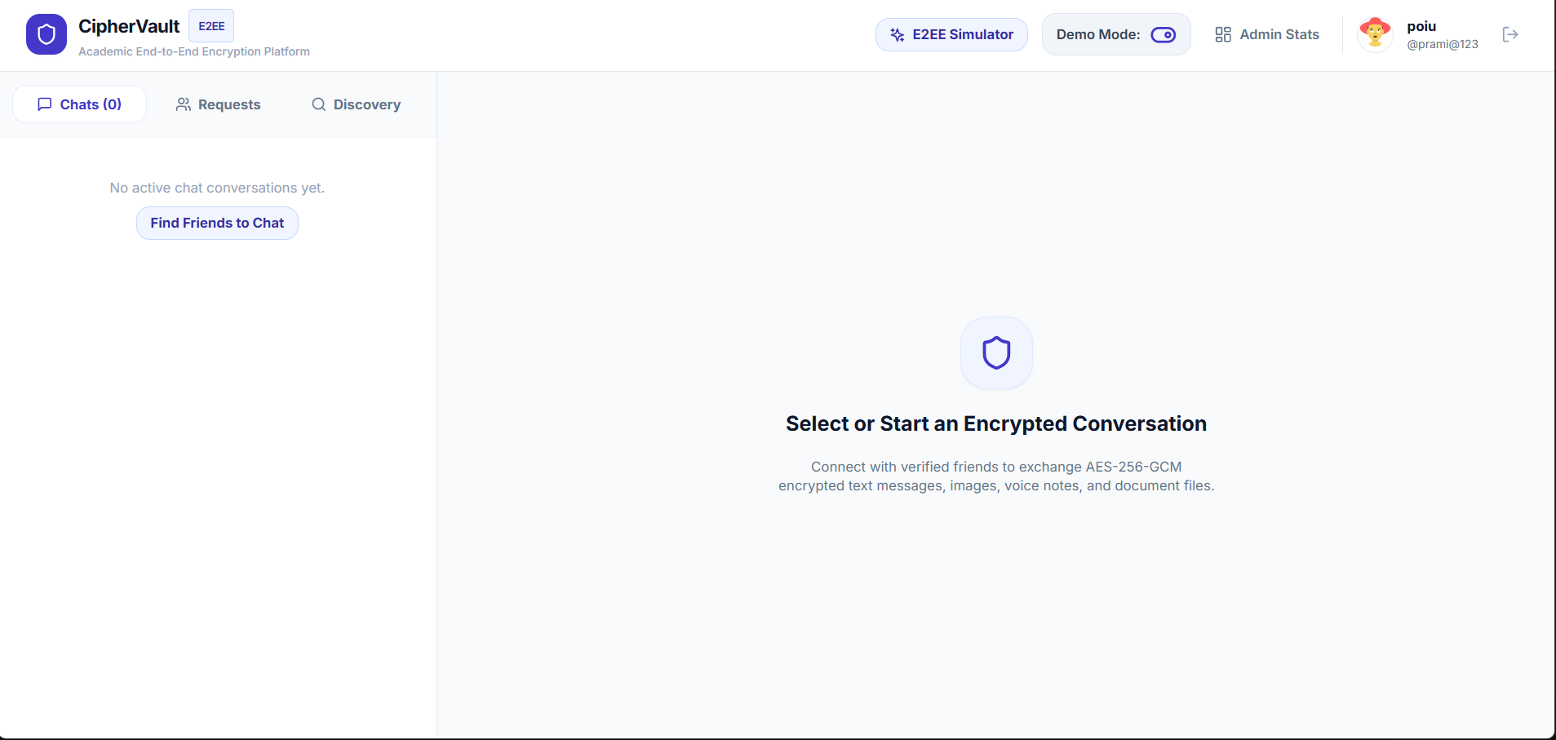
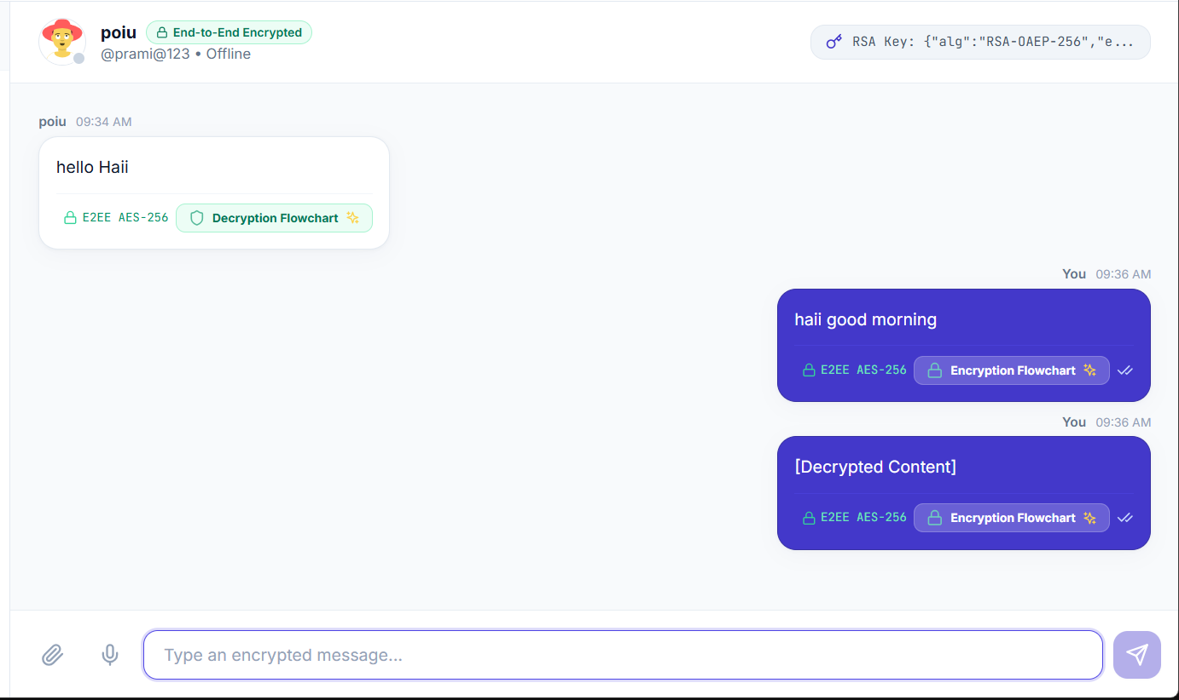
Module 2: Output

Slide 14
Module 3
Secure File & Database Management
Secure Chat Application
File Encryption
Mongo DB Management system
Securing data Encryption
Secure Note Transmission
File Data Integrity Verification
Encrypted Data Storage

Slide 15
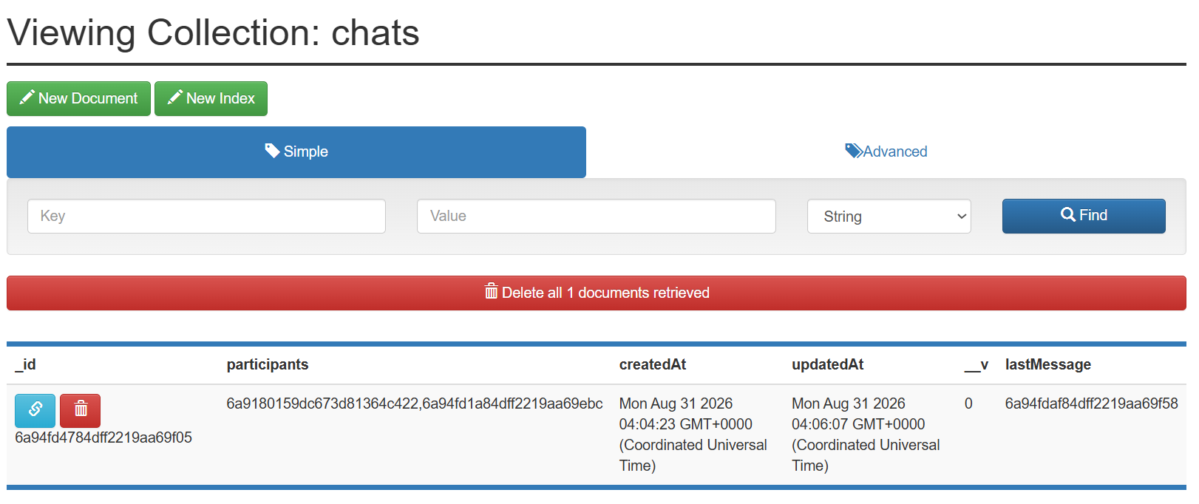
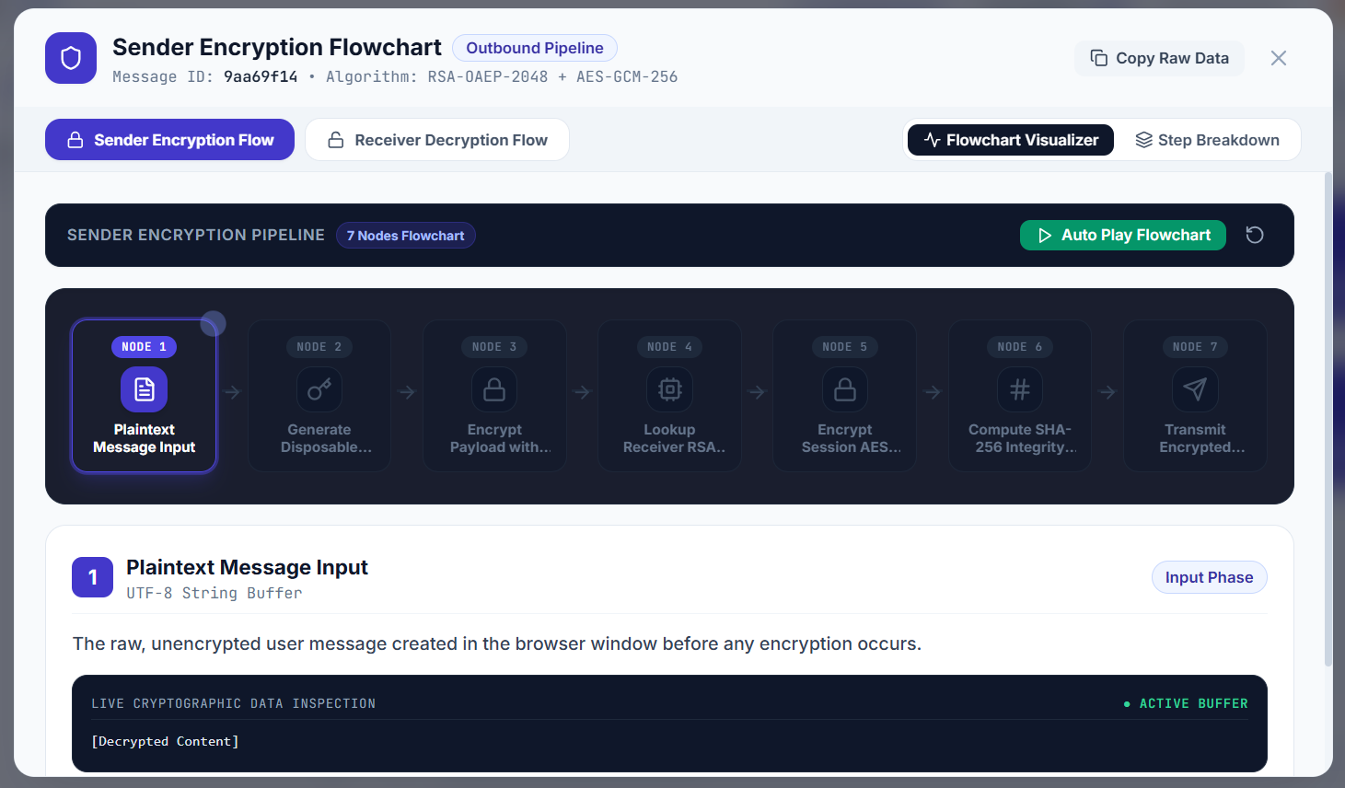
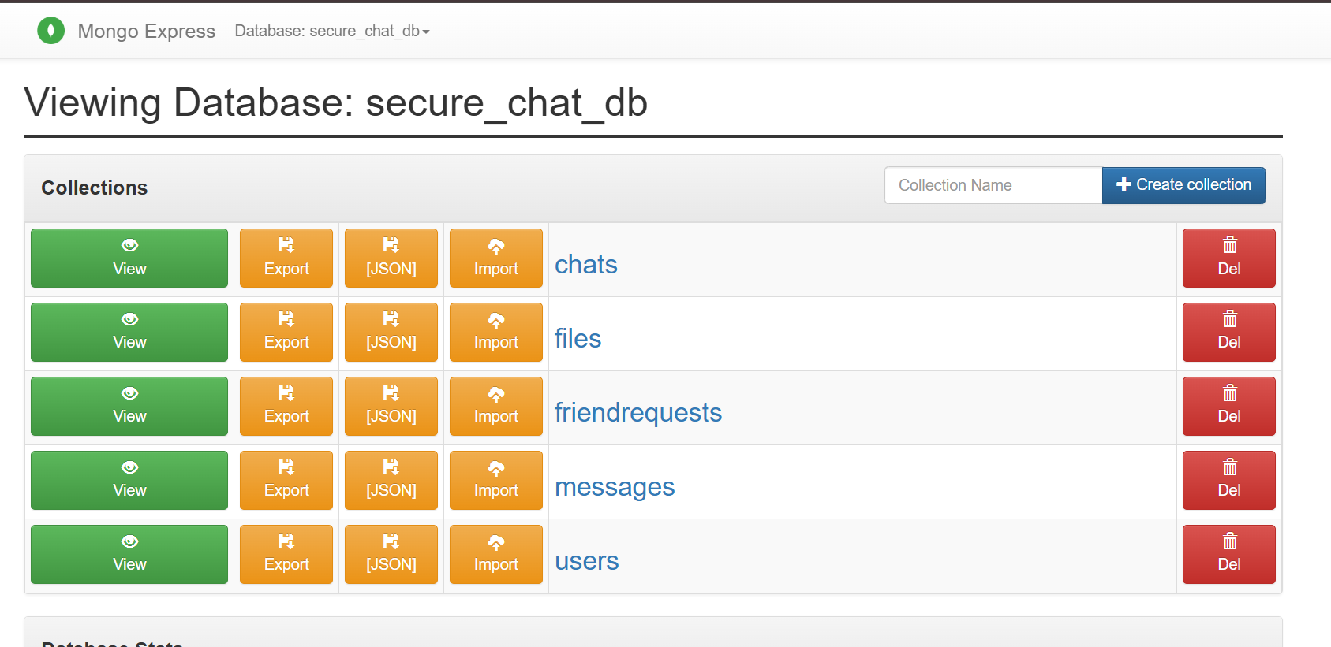
Module 3: Output

Slide 16

VALIDATION
Testing & Evaluation
Functional Testing
Security Testing
Performance Testing
User Registration
Classical Encryption Verification
Hybrid Handshake Latency
Login
Post-Quantum KEM Verification
Real-Time Messaging
Friend Request
Digital Signature Verification
Socket.IO Communication
Chat
SHA-256 Integrity
MongoDB Storage
File Sharing
JWT Authentication
Result: The framework successfully performs secure hybrid encrypted communication, remaining resilient against both classical and quantum computational attacks, while storing only encrypted data on the server.

Slide 17
IMPACT
Sustainable Development Goals (SDGs)
09
16
04
Industry, Innovation
& Infrastructure
Peace, Justice &
Strong Institutions
Quality
Education
Next-generation secure digital communication
Long-term privacy protection
Interactive hybrid/PQC visualization
Quantum-resilient software architecture
Secure and trustworthy digital exchange
Educational exposure to quantum-safe cryptography
Cybersecurity innovation for future infrastructure
Defense against future quantum-era threats
Practical implementation of emerging standards

Slide 18
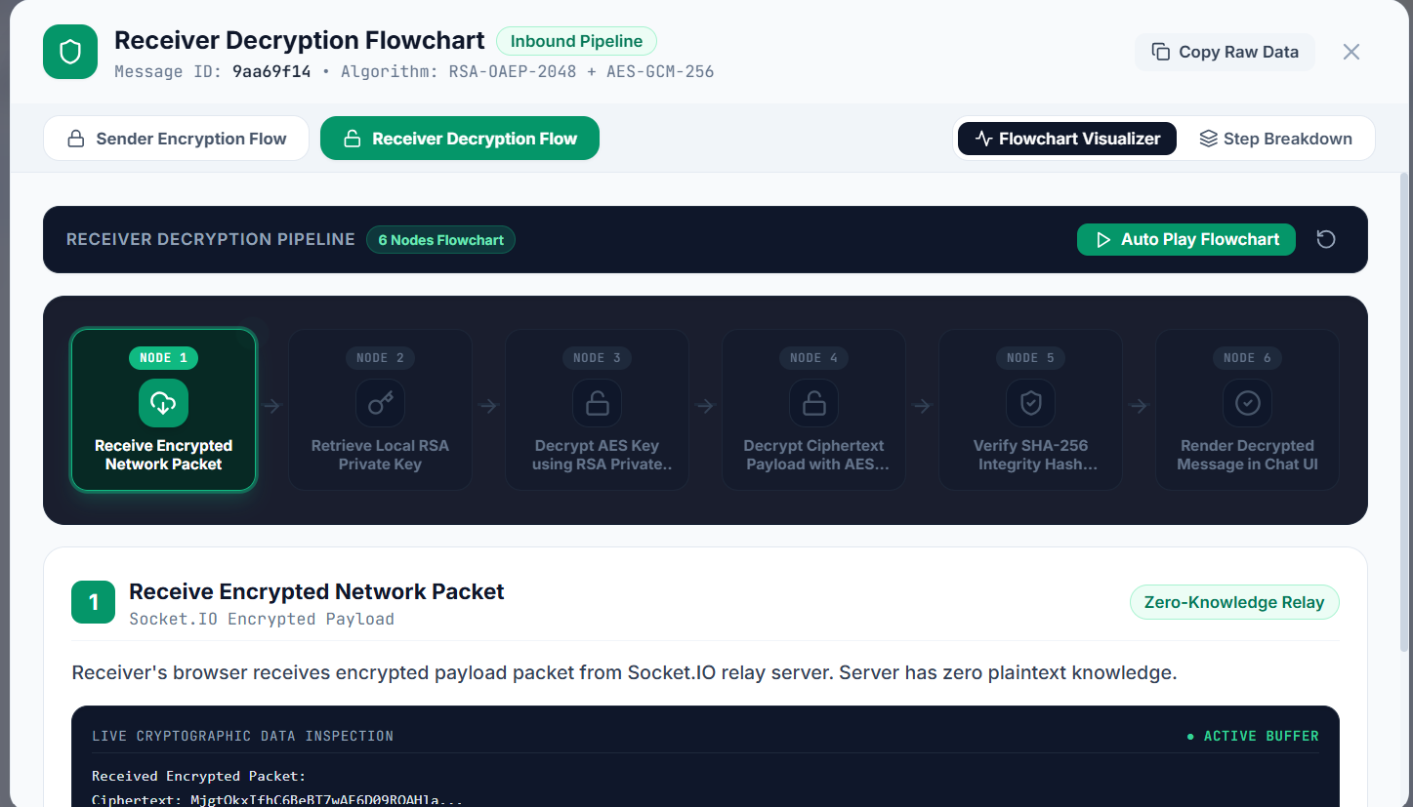
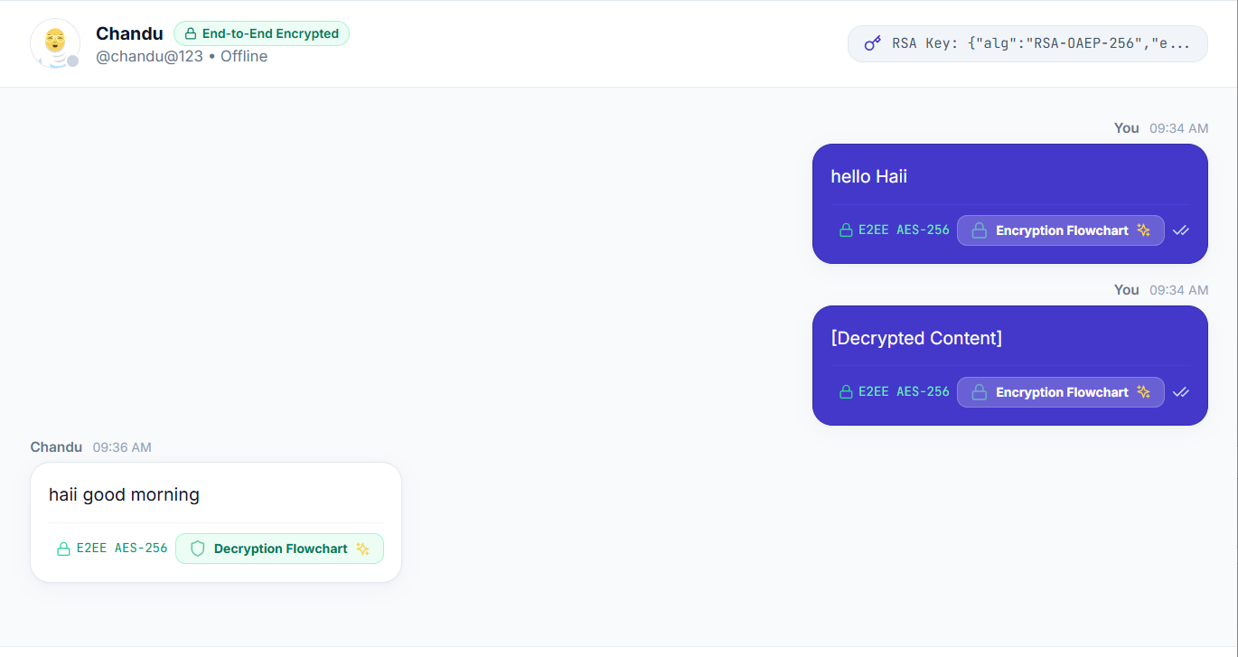
Final Application Outputs:-

Slide 19

WRAP-UP
Conclusion & Future Scope
Future Scope
Conclusion
NIST-standardized PQC migration
Mobile Application
Quantum Shield successfully demonstrates a secure, future-ready communication framework using a Hybrid Cryptographic model that combines proven classical algorithms with post-quantum cryptographic readiness.
Group Chat with Hybrid Encryption
Video Calling with Quantum-Safe Exchange
Secure real-time messaging
Multi-device Synchronization
Biometric Authentication
Hybrid classical + post-quantum cryptography
Zero plaintext storage
Push Notifications
AI-based Threat Detection
Resilience against "Harvest Now, Decrypt Later"
Educational cryptographic visualization
Scalable, quantum-ready architecture
Blockchain Identity Verification
Quantum Key Distribution (QKD)

Slide 20
Thank You
Questions & Answers
"Security must outlast the threats of tomorrow. Quantum Shield safeguards
communication today, against the computers of the future."

